Slide 1
COMP3028 Software Architecture

Slide 2
Mapping among Architectural Elements
For interoperability, the critical mapping is that of components to processors
Make sure that components that communicate externally are hosted on processors that can reach the network

Slide 3

Open Question
Points: 10
You are an architect on the team that designs the architecture for a system with high interoperability requirement. What design decisions regarding the resource management will you need to make?
Open Question is only supported on Version 2.0 or newer.
Answer

Slide 4
Resource Management
Interoperation with another system can never exhaust critical system resources
E.g., can a flood of requests cause service to be denied
Resource load imposed by communications is acceptable
If interoperation requires that resources be shared among the participating systems, an adequate policy is in place
E.g., bandwidth scheduling for video sharing

Slide 5
Binding Time
Determine when the systems become known to each other
It has a policy for dealing with binding to both known and unknown external systems
It has mechanisms to reject unacceptable bindings and to log such requests

Slide 6
Summary
Interoperability refers to the ability of systems to usefully exchange information.
Achieving interoperability involves the relevant systems locating each other and then managing the interfaces so that they can exchange information.

Slide 7
Universal Adaptor: A Novel Approach to Supporting Multi-protocol Service Discovery in Pervasive Computing
Joanna Izabela Siebert, Jiannong Cao, Yu Zhou, Miaomiao Wang, and Vaskar Raychoudhury,
In Proceedings of International Conference on Embedded and Ubiquitous Computing (EUC’07), pp. 683-693, December, 2007,
Notes:
7

Slide 8
Your task
While listening to this part of our topic, try to think about this question “which tactics was used in this research to achieve interoperability between the discovery mechanisms?”

Slide 9
Background
Heterogeneity - different environments supported by different service management systems, which may use standard protocols as well as tailored made mechanisms
software,
hardware devices,
network infrastructures
Diverse service discovery mechanisms
How to integrate or bridge these service discovery schemes ?

Slide 10
Interoperability Requirements
No change should be imposed on the existing service discovery mechanisms
No change should be imposed on the services registered in domains
No functionality of the environment should be compromised
The system should be lightweight, scalable, and extendable
Support both standard and tailor-made service discovery mechanisms

Slide 11
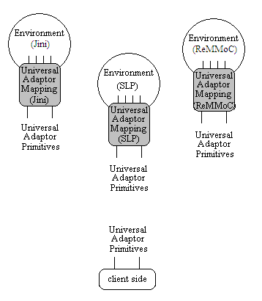
System Model and Architecture
Environment
Service Discovery Domain, where a native service discovery system is able to find a specified resources if they are available in the domain.
Services
provided by hardware devices, software, and other entities
Examples: weather forecast, stock quotes, and language translation. - provided directly or via another device

Slide 12
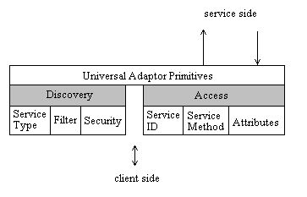
Universal Adaptor Primitives (UAP)
[Return_Values] Primitive_Name [Parameters]
[RV_ST, RV_F, RV_S] Discovery (Service Type, Filter, Security)
[RV_status] Access (ServiceID, Service Method, Attributes)

Slide 13
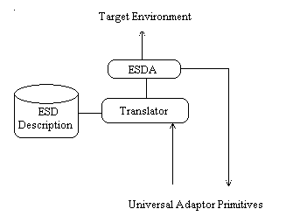
Universal Adaptor Mapping (UAM)
ESDA - Agent that uses the algorithm generated by Translator to perform service discovery in the target environment. Depending on the native service discovery protocol, ESDA can register for service advertisements or performs active service discovery
Translator - Module that translates UA primitives into native primitives, and outputs an algorithm for service discovery using the native primitives
ESD Description - Rules specifying the characteristics of the service discovery protocol used in the particular environment, in the form of the primitives extracted from the native protocol

Slide 14
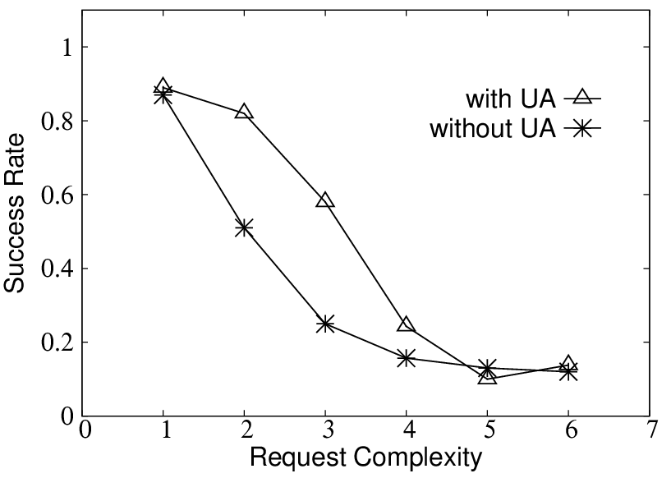
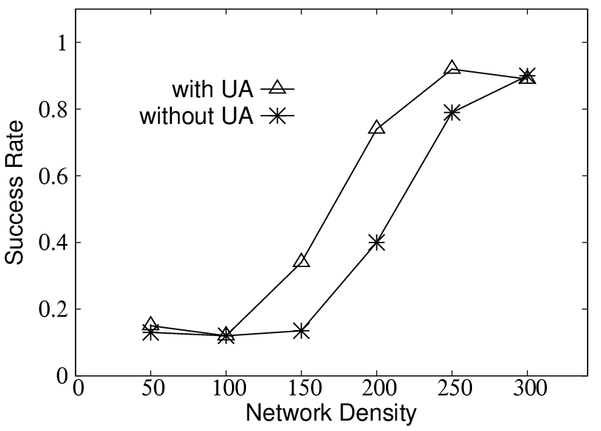
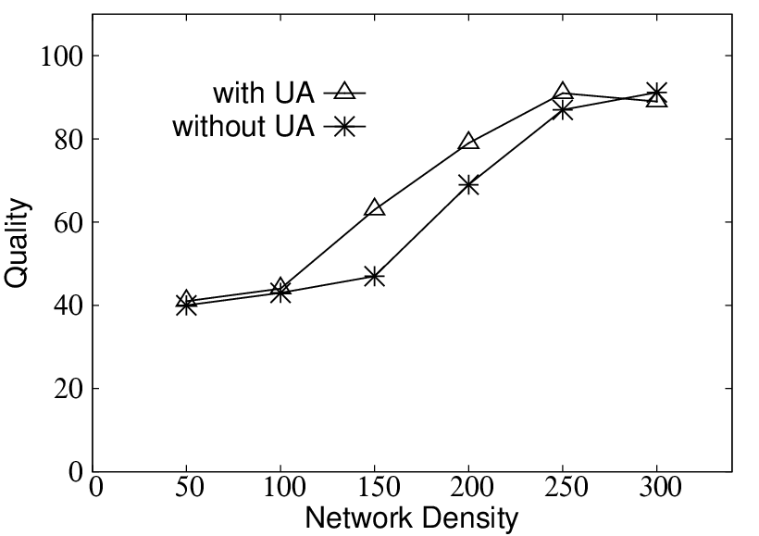
Simulation Results
For the too sparse network, neither approach with UA not without UA can achieve good results.
The more neighbors the node has the bigger success rate of finding the preferred collaboration partner, quality improves as well.
When the network is very dense, the improvement is not visible any more - additional neighbors available for the node to choose from are treated as duplication.
Approach with UA always results with providing bigger choice to the node, which in turn gives better success rate and higher quality.
With UA and without UA results are not very symmetric. The network for the approach with UA becomes “too dense” earlier than for the approach without UA.

Slide 15
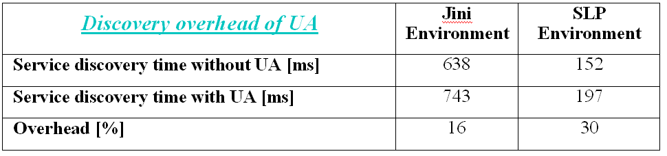
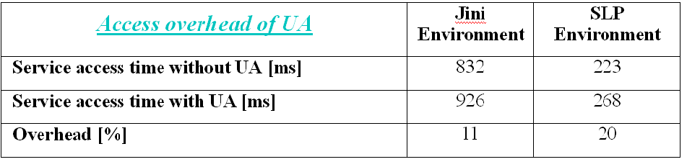
Experiment Results
Two service discovery environments:
Jini - Jini2_1
SLP - jSLP
Example: a weather information service

Slide 16
Interoperability Tactics

Slide 17
Poll
1 answer(s) at most
Which tactics was used in this research to achieve interoperability between the discovery mechanisms?
A
Discover service
B
Orchestrate
C
Tailor interface
Submit

Slide 18
Multiple Choice(single)
Points: 1
Which tactics was used in this research to achieve interoperability between the discovery mechanisms?
A
Discover service
B
Orchestrate
C
Tailor interface
Submit

Slide 19
Universal Adaptor Primitives (UAP)
Interface primitives
[Return_Values] Primitive_Name [Parameters]
[RV_ST, RV_F, RV_S] Discovery (Service Type, Filter, Security)
[RV_status] Access (ServiceID, Service Method, Attributes)

Slide 20
Universal Adaptor Mapping (UAM)
ESDA - Agent that uses the algorithm generated by Translator to perform service discovery in the target environment. Depending on the native service discovery protocol, ESDA can register for service advertisements or performs active service discovery
Translator - Module that translates UA primitives into native primitives, and outputs an algorithm for service discovery using the native primitives
ESD Description - Rules specifying the characteristics of the service discovery protocol used in the particular environment, in the form of the primitives extracted from the native protocol

Slide 21
Manage Interfaces
Orchestrate: uses a control mechanism to coordinate, manage and sequence the invocation of services.
Orchestration is used when systems must interact in a complex fashion to accomplish a complex task.
Tailor Interface: add or remove capabilities to an interface such as translation, buffering, or data-smoothing.

Slide 22
Interoperability Tactics

